Slide 1
Understanding and using the kit: Training of trainers for facilitators Module 4: Choosing and planning activity phases
The Adolescent Development and Participation Section
Priya Marwah, Adolescents in Emergencies and Peacebuilding Specialist
Ellen Fransen, Programme Assistant
Juliet Young, Consultant

Slide 2
4.1 Planning sessions for adolescents using the Activity Box

Slide 3
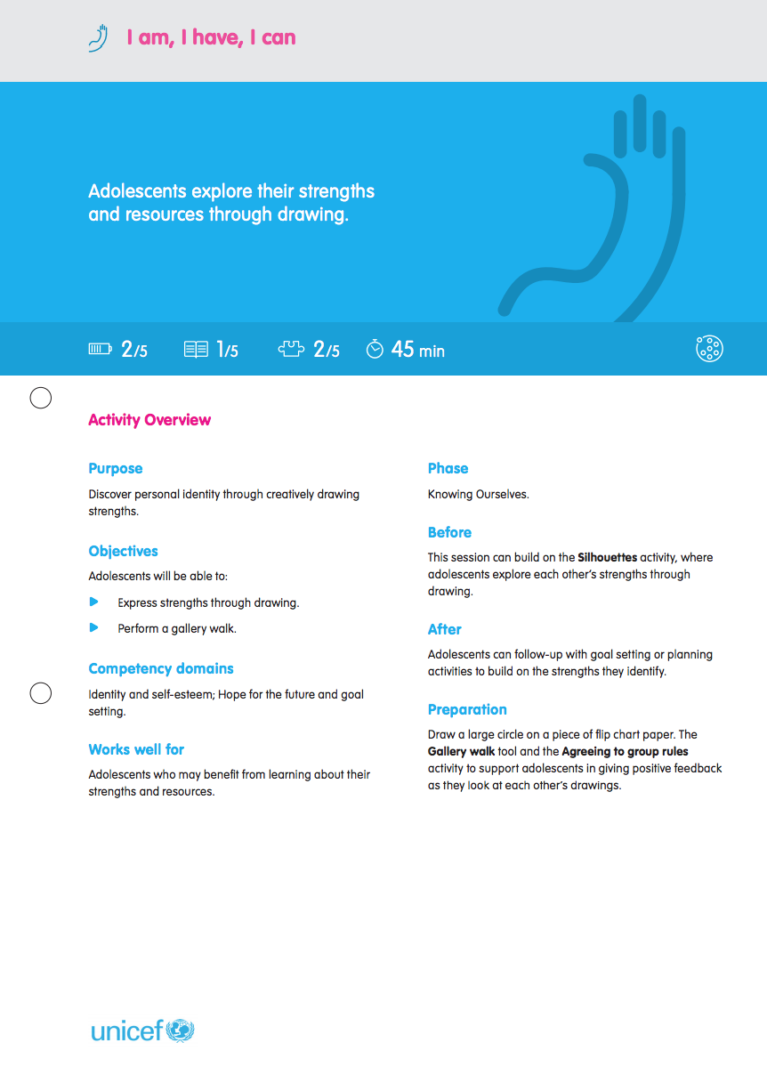
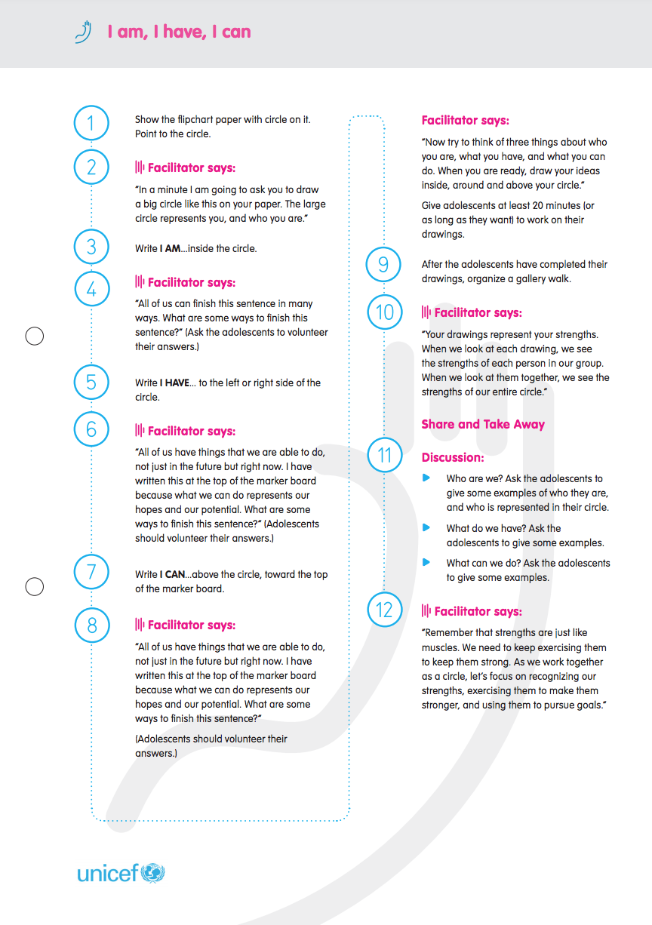
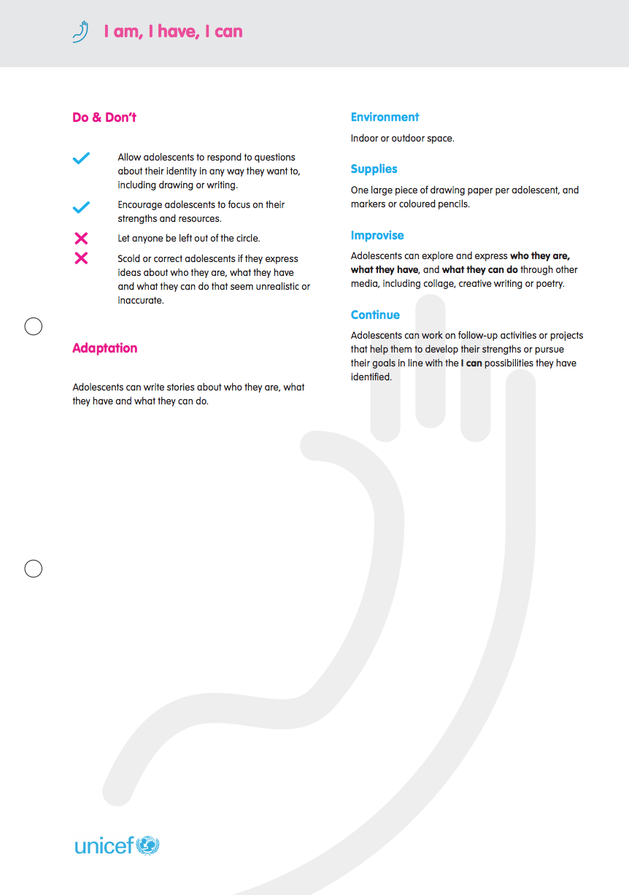
Using the Activity Cards
Notes:
Notes for trainer:
(NB: Use these notes for this slide and the two that follow.)
The overall purpose of this module is to orient workshop participants to the Activity Box, so that they can use the resources in it to plan sessions for their Adolescent Circles.
It is recommended that you have at least one entire Activity Box available for participants’ hands-on review throughout the module.
Each participant should also have one copy of the Activity Guide key to icons and information tool.
Refer to the Activity Guide key to icons and information tool. Explain each category of information, and how facilitators can use that information to choose and adapt activities and to create their own activities as they plan sessions for adolescents.
Ref: Activity Guide key to icons and information tool.
Ref: The Activity Box (entire), or at least one sample Activity Guide per workshop participant

Slide 4
Using the Activity Cards
Notes:
Note for trainer:
(Refer to notes for slide 4)
Ref: Activity Guide key to information and icons tool.
Ref: The Activity Box (entire), or at least one sample Activity Guide per workshop participant

Slide 5
Using the Activity Cards
Notes:
Notes for trainer:
(Refer to notes for slide 4)
Ref: Activity Guide key to information and icons tool.
Ref: The Activity Box (entire), or at least one sample Activity Guide per workshop participant

Slide 6
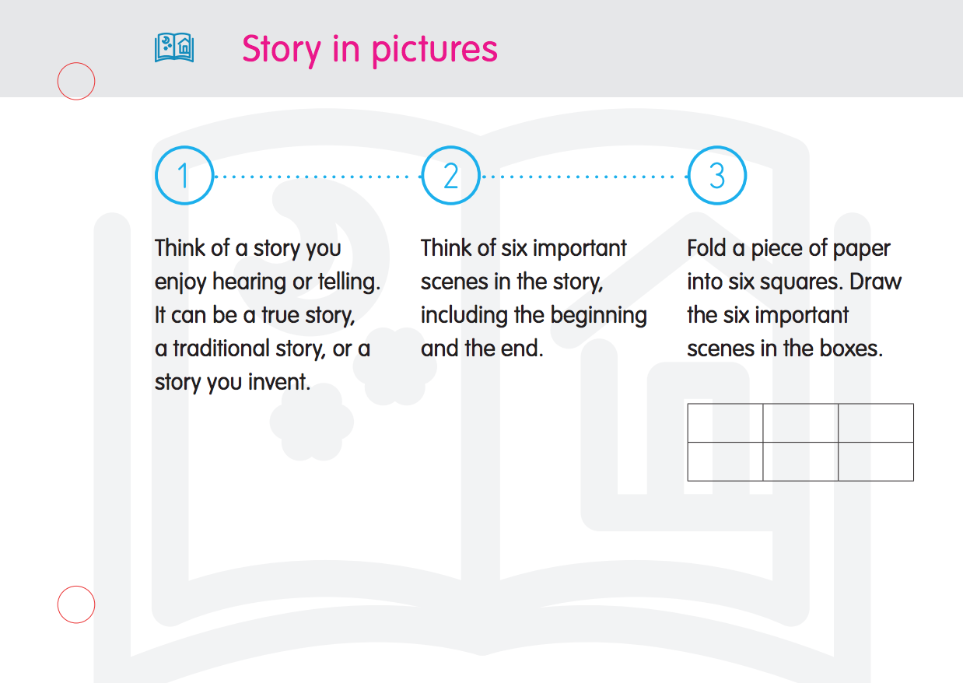
Using the Inspiration Cards
Notes:
Notes for trainer:
Inspiration cards are cards with simple ideas to give facilitator and adolescents an inspiration when they need one.
Facilitators can use the cards to plan an activity in advance.
A more advanced group of adolescents (in the ‘Connecting’ or ‘Take Action’ cycle) may enjoy browsing the ‘inspiration cards’ themselves. They can use them as ‘inspiration’ for a short game or a long-term project, or take the lead by planning and facilitating an activity themselves using an idea from the card.
Ref: The Activity Box (entire), or at least one sample Inspiration Card per workshop participant

Slide 7
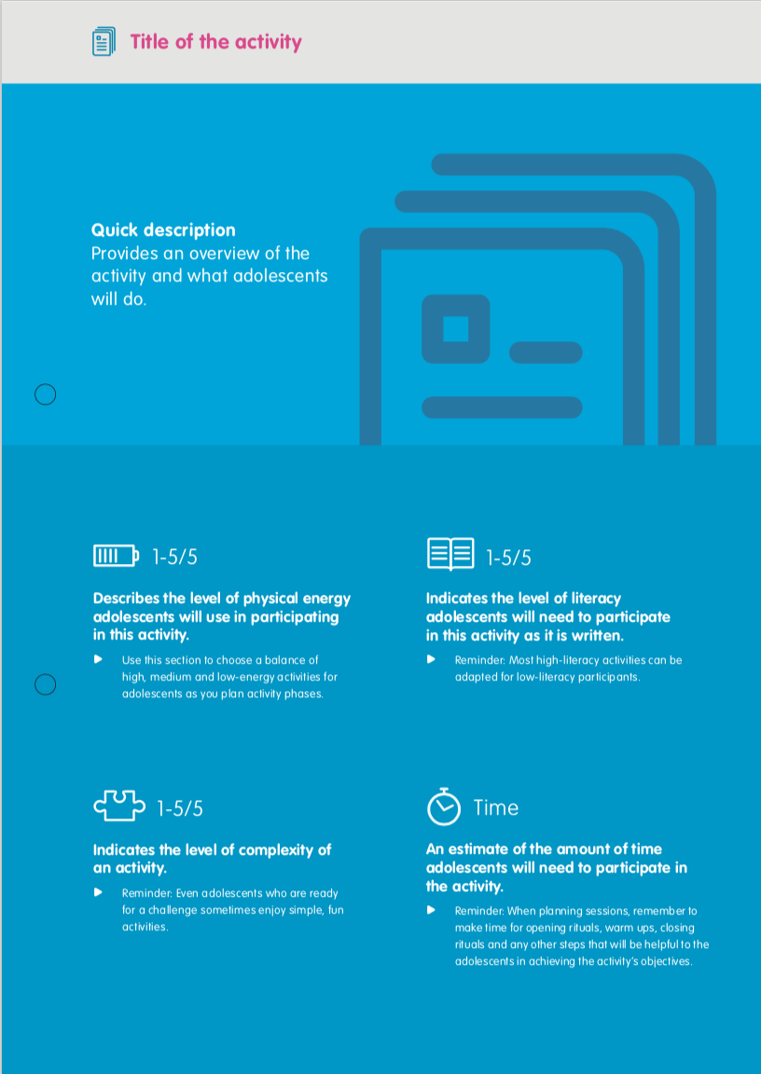
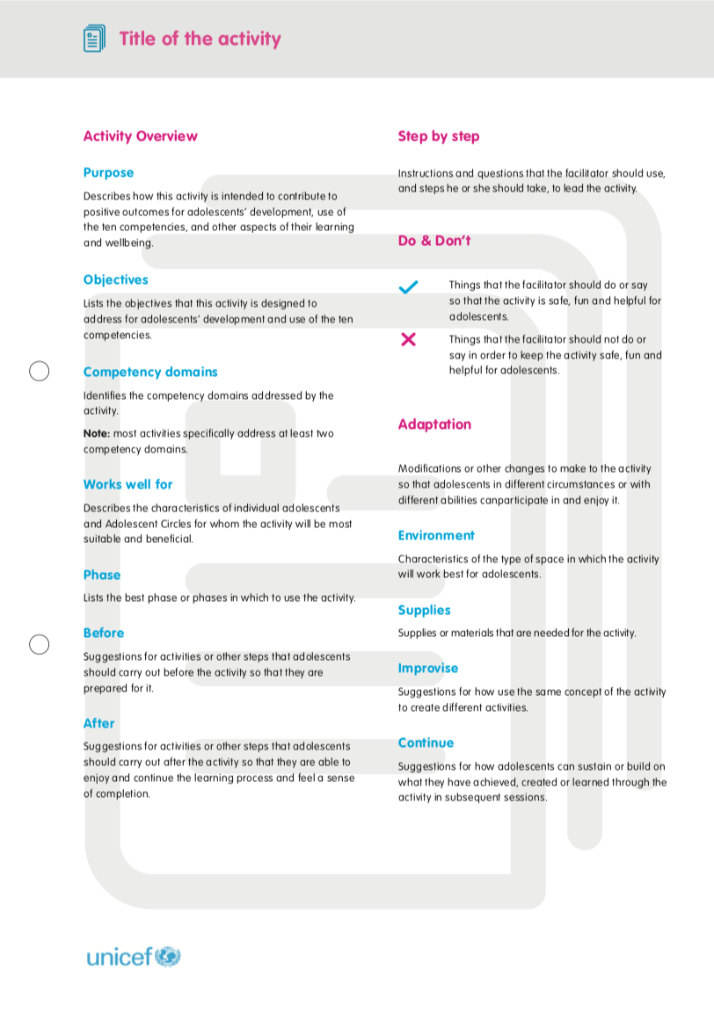
Create your own activity!
Use the Key to Activity Icons as a template, and design (or document) an activity you invent for or with your adolescent circle.
Make space for
creativity and expression
Notes:
Notes for trainer:
Explain that participants can use the Activity Planning Tool to create new activities for adolescents, whether by ‘improvising’ with ideas from the Activity Guides, Energizer Guides, or Inspiration Cards, using their own original ideas, or encouraging and supporting adolescents to come up with their own original ideas.
Ref: Activity Planning tool

Slide 8
4.2 Planning Activity Phases
Notes:
Cover slide for this first section of the webinar.

Slide 9
What are Activity Phases?
Instead of including an activity manual or pre-planned modules, the Adolescent Kit provides guides and tools that can be used as building blocks to create activity phases.
A phase has a flexible timeline, so the adolescents (in a Circle) can continue in one phase for a short time or a long time, depending on what works for them.
An Adolescent Circle can repeat a phase, or move back and forth to different phases, based on their own interests and priorities.
Notes:
Notes for trainer:
Read this slide aloud, or ask one of the workshop participants to do so.
Ref: Facilitators’ Guide, Choosing and planning activity phases

Slide 10
What are Activity Phases? (continued)
Facilitators plan and adapt activity phases, which are sequences of activities, based on the situation, needs, interests and priorities of an adolescent circle.
The Facilitator’s Guidance provides tools and recommendations for facilitators to choose and planning activity phases, with and for adolescents.
The next step in this training is to learn more about the ‘Four Phases.’ Then we will move into planning.
Notes:
Notes for trainer:
Read this slide aloud, or ask one of the workshop participants to do so.

Slide 11
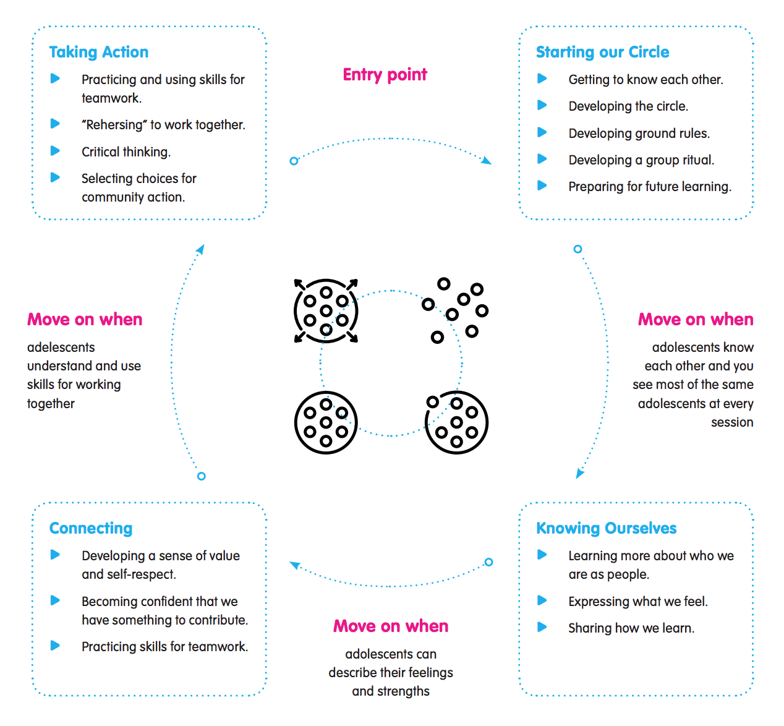
The Four Activity Phases
Notes:
Notes for trainer:
Explain that this diagram presents an overview of the four phases, the competencies that adolescents are developing and using in each, and when and why they might move from one phase to the next.
Highlight that adolescents do not need to progress ‘forward’ from one phase to the next – but instead can move back and forth depending on their interests and priorities, and other factors that affect their circumstances. For example, if an Adolescent Circle wants a relaxing break after carrying out projects in the ‘Take Action’ phase they can move back to any other phase to participate in easier, more relaxing activities. If many new adolescents join a programme or intervention, it may be helpful to move to the ‘Starting our Circle’ phase so that all participants have a chance to get to know each other and begin a new phase of activities with a fresh start.
Use this slide as a brief overview to introduce the phases, which are described and explained in detail in the next steps.
Ref: Facilitators’ Guide, Choosing and planning activity phases

Slide 12
Starting Our Circle Phase
Includes:
Simple, short sessions, sometimes with a few very short activities during the same session
Mix of active and quiet activities
Different activities in every session, with no connection from one session to the next
Best for:
Any Adolescent Circle that is coming together for the first time, and whose members do not know each other yet
Younger adolescents
Adolescents who have recently experienced a crisis or displacement, and are adjusting to a new situation
A Circle in which different adolescents come and go every day
Notes:
Notes for trainer:
Read this slide aloud, or ask one of the workshop participants to do so.
Ref: Facilitators’ Guide, Choosing and planning activity phases

Slide 13
Knowing Ourselves Phase
Includes:
Simple, short sessions, but with one main activity in each session
Variation between active and quiet activities
Activities in which adolescents mostly work individually, but have some chance to get to know each other
Best for:
A Circle in which adolescents have had a chance to meet each other
Adolescents who have recently experienced a crisis or displacement and are not ready to do complex projects
Younger adolescents
Notes:
Notes for trainer:
Read this slide aloud, or ask one of the workshop participants to do so.
Ref: Facilitators’ Guide, Choosing and planning activity phases

Slide 14
Connecting Phase
Includes:
Longer sessions, depending on adolescents’ schedules
More focus on learning and practicing skills, and teamwork
Some sessions with activities that connect from one to the next
Best for:
Adolescents who are in a protracted emergency or stable context and participate consistently in sessions
A Circle in which adolescents, and are ready and interested to work together
Adolescents who want to learn about each other, and the community world around them
Notes:
Notes for trainer:
Read this slide aloud, or ask one of the workshop participants to do so.
Ref: Facilitators’ Guide, Choosing and planning activity phases

Slide 15
Taking Action Phase
Includes:
Longer sessions, depending on adolescents’ schedules
Projects planned, organized and carried out by adolescents themselves, based on their interests and ideas.
Best for:
Older adolescents
Adolescents who are in a protracted emergency or stable context and can participate consistently
Adolescents who know others in their Circle, and can work well as a strong team
Adolescents who want to take on the challenge of planning and leading their own projects
Notes:
Notes for trainer:
Read this slide aloud, or ask one of the workshop participants to do so.
Ref: Facilitators’ Guide, Choosing and planning activity phases

Slide 16
The Four Activity Phases
Notes:
Notes for trainer:
Revisit the explanation given on slide 11.
Explain that this diagram presents an overview of the four phases, the competencies that adolescents are developing and using in each, and when and why they might move from one phase to the next.
Highlight that adolescents do not need to progress ‘forward’ from one phase to the next – but instead can move back and forth depending on their interests and priorities, and other factors that affect their circumstances. For example, if an Adolescent ircle wants a relaxing break after carrying out projects in the ‘Take Action’ phase they can move back to any other phase to participate in easier, more relaxing activities. If many new adolescents join a programme or intervention, it may be helpful to move to the ‘Starting our Circle’ phase so that all participants have a chance to get to know each other and begin a new phase of activities with a fresh start.
Ask workshop participants if they have questions.
Respond to questions or give workshop participants an opportunity to discuss them in plenary.
Ref: Facilitators’ Guide, Choosing and planning activity phases

Slide 17
Discussion/reflection:
Which of the Ten Key Approaches do you see reflected in this process of using and moving through Activity Phases?
Notes:
Notes for trainer:
Possible answers include:
Listen to adolescents: Facilitators should talk with and listen to adolescents to find out how they are enjoying the activities.
Put adolescents in the lead: Adolescents decide when they are ready to move on or stay with a phase.
Improvise and adapt: Make changes in plans based on adolescents’ needs, interests and preferences, and how they grow and develop.

Slide 18
4.3 Choosing an Activity Phase
Notes:
Cover slide for this first section of the webinar.

Slide 19
How should you choose and plan a phase for your Adolescent Circle?
Use the ‘Circle Assessment Tool’ to learn more from adolescents about their interests and choose a phase they will enjoy.
Use ‘Setting group goals’ to learn more from adolescents about their interests and choose activities they will enjoy.
Plan sequences of activities for adolescents, using and adapting the Activity Guides and your own ideas.
Talk with adolescents and use your own judgment!
Be flexible, and change to a different phase if adolescents aren’t engaged or enjoying activities.
Improvise and Adapt
Notes:
Notes for trainer:
Explain to workshop participants that there are several guides, tools and processes in the Adolescent Kit for Expression and Innovation that they can use to determine what activity phase might work best for adolescents in their programme or intervention.
Review the references to the guidance and tools listed above, and explain how facilitators can use each of these to choose and plan activities for their adolescent circle
Emphasize that facilitators should also talk with adolescents and use their own judgment in choosing a phase
Emphasize that the phases are intended to be flexible. If facilitators feel that adolescents are not having fun, or are not interested or engaged, they should change phases.

Slide 20
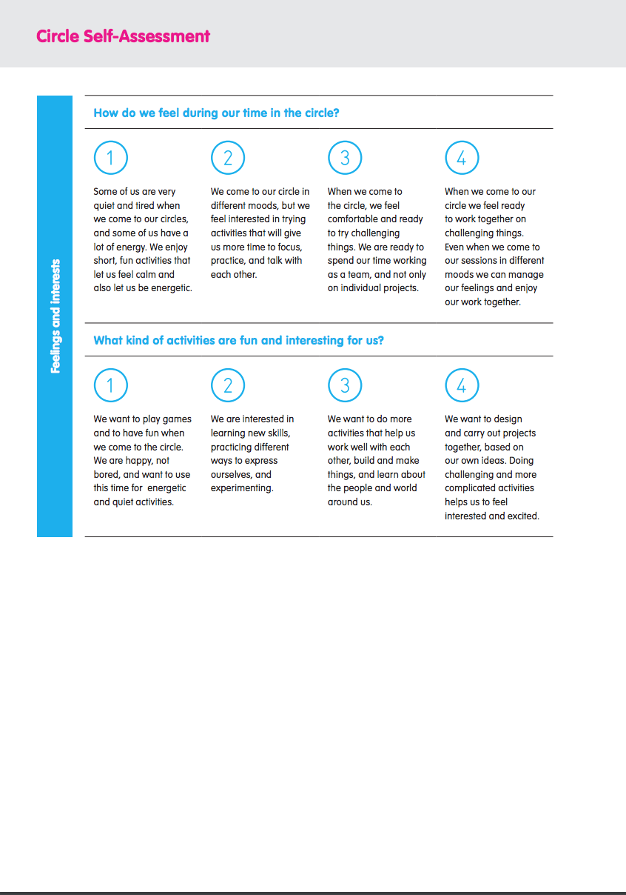
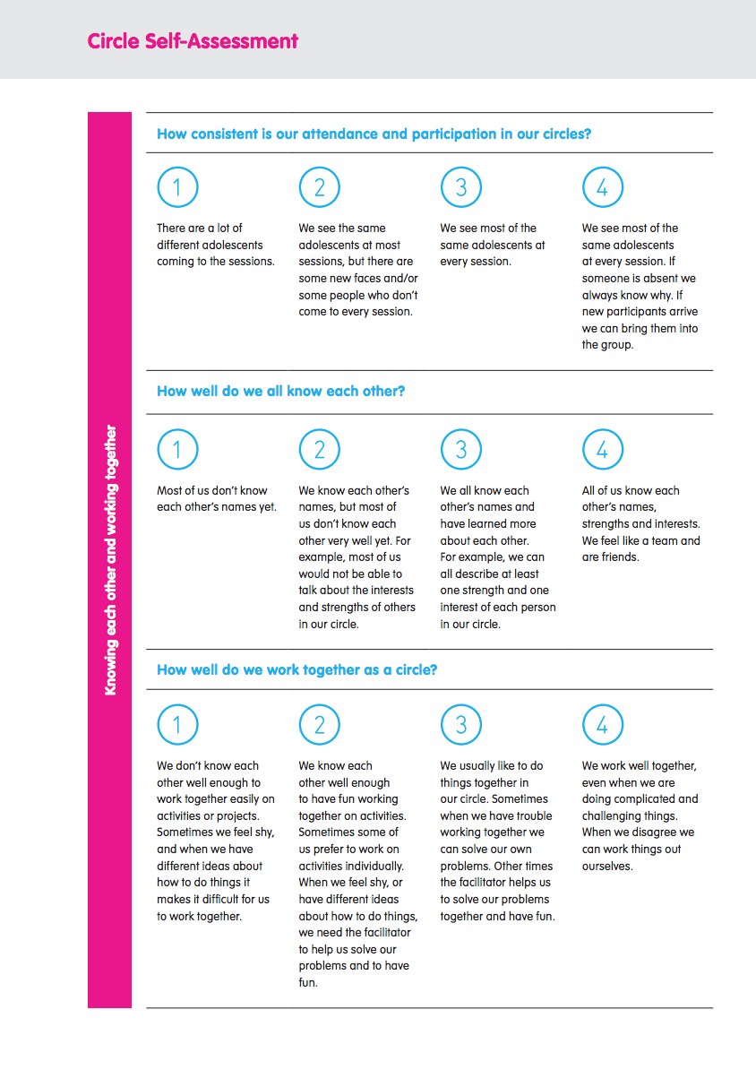
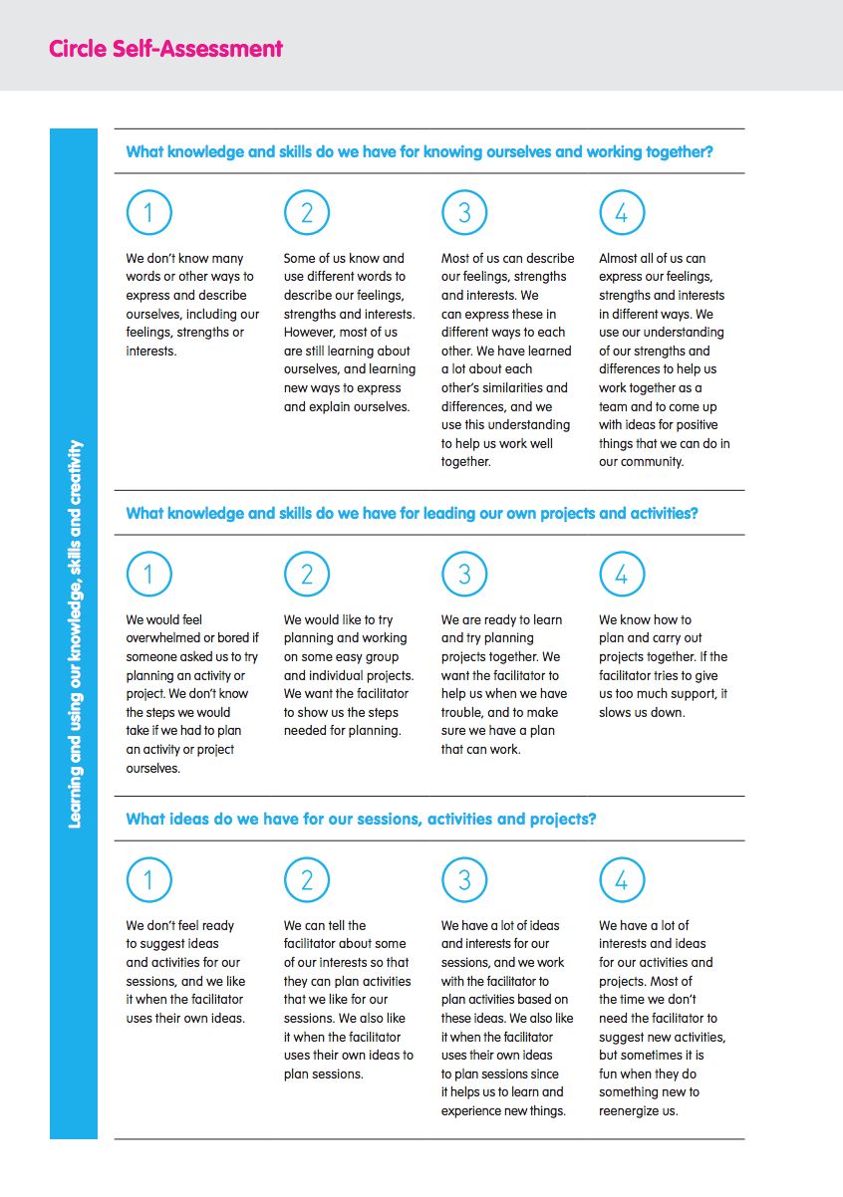
Use the ‘Circle Assessment Tool’ in the Facilitator Tools to assess adolescents’ ‘circle strength’ and choose an appropriate cycle to begin your intervention.
Notes:
Notes for trainers:
Organize participants into small groups. In this activity, they will use the ‘Circle assessment tool’ to assess their own strength as a group (circle).
If necessary, clarify that workshop participants are assessing their strength as a group – not (yet) assessing the strength of the Adolescent Circle with whom they work.
Ref: Circle assessment tool

Slide 21
Notes:
Notes for trainers:
(NB: Use these notes for this slide and the three that follow.)
Participants should have the Circle Assessment Tool available for their use for this group activity.
Use the slides to explain the information presented in the tool (if that would be helpful), or, if they prefer, let participants review and use it without explanation.
Explain that each small group should choose the answer to each question that best describes their group.
When they have answered all questions, they should choose the number (1, 2, 3, or 4) that best corresponds with their strength as a group (circle), and therefore with the phase that would work best for them (1 = Starting Our Circle; 2 = Knowing Ourselves; 3 = Connecting; 4 = Taking Action)
Explain that participants should make a holistic decision on the number that best corresponds with their strength as a group (and therefore the activity phase that would most appropriate for them).
Ref: Circle assessment tool

Slide 22
Notes:
Notes for trainers:
Participants should have the Circle Assessment Tool available for their use for this group activity.
Use the slides to explain the information presented in the tool (if that would be helpful), or, if they prefer, let participants review and use it without explanation.
Explain that each small group should choose the answer to each question that best describes their group.
When they have answered all questions, they should choose the number (1, 2, 3, or 4) that best corresponds with their strength as a group (circle), and therefore with the phase that would work best for them (1 = Starting Our Circle; 2 = Knowing Ourselves; 3 = Connecting; 4 = Taking Action)
Explain that participants should make a holistic decision on the number that best corresponds with their strength as a group (and therefore the activity phase that would most appropriate for them).
Ref: Circle assessment tool

Slide 23
Notes:
Notes for trainer:
Participants should have the Circle Assessment Tool available for their use for this group activity.
Use the slides to explain the information presented in the tool (if that would be helpful), or, if they prefer, let participants review and use it without explanation.
Explain that each small group should choose the answer to each question that best describes their group.
When they have answered all questions, they should choose the number (1, 2, 3, or 4) that best corresponds with their strength as a group (circle), and therefore with the phase that would work best for them (1 = Starting Our Circle; 2 = Knowing Ourselves; 3 = Connecting; 4 = Taking Action)
Explain that participants should make a holistic decision on the number that best corresponds with their strength as a group (and therefore the activity phase that would most appropriate for them).
Ref: Circle assessment tool

Slide 24
Notes:
Notes for trainer:
Participants should have the Circle Assessment Tool available for their use for this group activity.
Use the slides to explain the information presented in the tool (if that would be helpful), or, if they prefer, let participants review and use it without explanation.
Explain that each small group should choose the answer to each question that best describes their group.
When they have answered all questions, they should choose the number (1, 2, 3, or 4) that best corresponds with their strength as a group (circle), and therefore with the phase that would work best for them (1 = Starting Our Circle; 2 = Knowing Ourselves; 3 = Connecting; 4 = Taking Action)
Explain that participants should make a holistic decision on the number that best corresponds with their strength as a group (and therefore the activity phase that would most appropriate for them).
Ref: Circle assessment tool

Slide 25
Notes:
Notes for trainers:
Ask each group to share their decision regarding which number best corresponds with their group (circle) strength. They may also share a summary of any key points that helped them to make their assessment (but it may not be necessary for them to share an explanation of their answer to each of the 8 questions on the Circle Assessment Tool).
For those who have been participating in a workshop together for 2-3 days, level 2 (Knowing Ourselves) or level 3 (Connecting) is often the most appropriate choice because…
By this point in the workshop they should know each other’s names
They should have some basic comfort with each other, and capacities to communicate their interests and goals with each other and the facilitator
They are likely to feel interested and motivated to take on some challenges together
They have not yet had the opportunity to form a strong sense of team membership (which would correspond with the ‘Taking Action’ phase.
If participants have chosen level 2 or level 3, this indicates that they have grasped the concepts intended in this module.
Highlight that workshop participants may have the capacity to move forward from the ‘Starting our Circle’ phase more quickly than the adolescents with whom they work, based on adolescents’ level of development, and also on their circumstances (e.g. if they are recently displaced, adjusting to a new environment and/or have recently experienced crises).
However, even as adults and professionals, they would need time and practice to be at a level of circle strength that prepares them for the Take Action phase.
Ref: Circle assessment tool

Slide 26
Reminder:
As you choose and plan a phase for your Adolescent Circle…
Use the ‘Circle Assessment Tool’ and the “Move or stay” activity with adolescents to decide if they will continue in the same phase or begin a new one.
Use ‘Setting group goals’ to learn more from adolescents about their interests and choose activities they will enjoy.
Plan sequences of activities for adolescents, using the Activity Guides, adapting them and adding your own ideas.
Talk with adolescents and use your own judgment!
Be flexible, and change to a different phase if adolescents aren’t engaged or enjoying activities.
Improvise and Adapt
Discussion/reflection:
What phase would work best for the adolescent with whom you are working, and why?
Notes:
Notes for trainer:
Ask participants to share their informal and immediate assessment for which phase will work best for the adolescents with whom they are working.
Reminder: If they preparing to work with a group of adolescents for the first time, it is almost always a good idea to start with the ‘Starting our circle’ phase. A new Adolescent Circle can then take as much or as little time as they need to be ready to move on to a new phase together.
Facilitators should use their own formal and informal assessments and judgment about when Adolescent Circles should move to a new phase, but they can also consult directly with adolescents using the Move or Stay Activity, as well as the Circle Assessment Tool.
Ref: Circle assessment tool
Ref: Activity Guide: Move or Stay

Slide 27
4.4 Planning an Activity Phase
Notes:
Cover slide for this first section of the webinar.

Slide 28
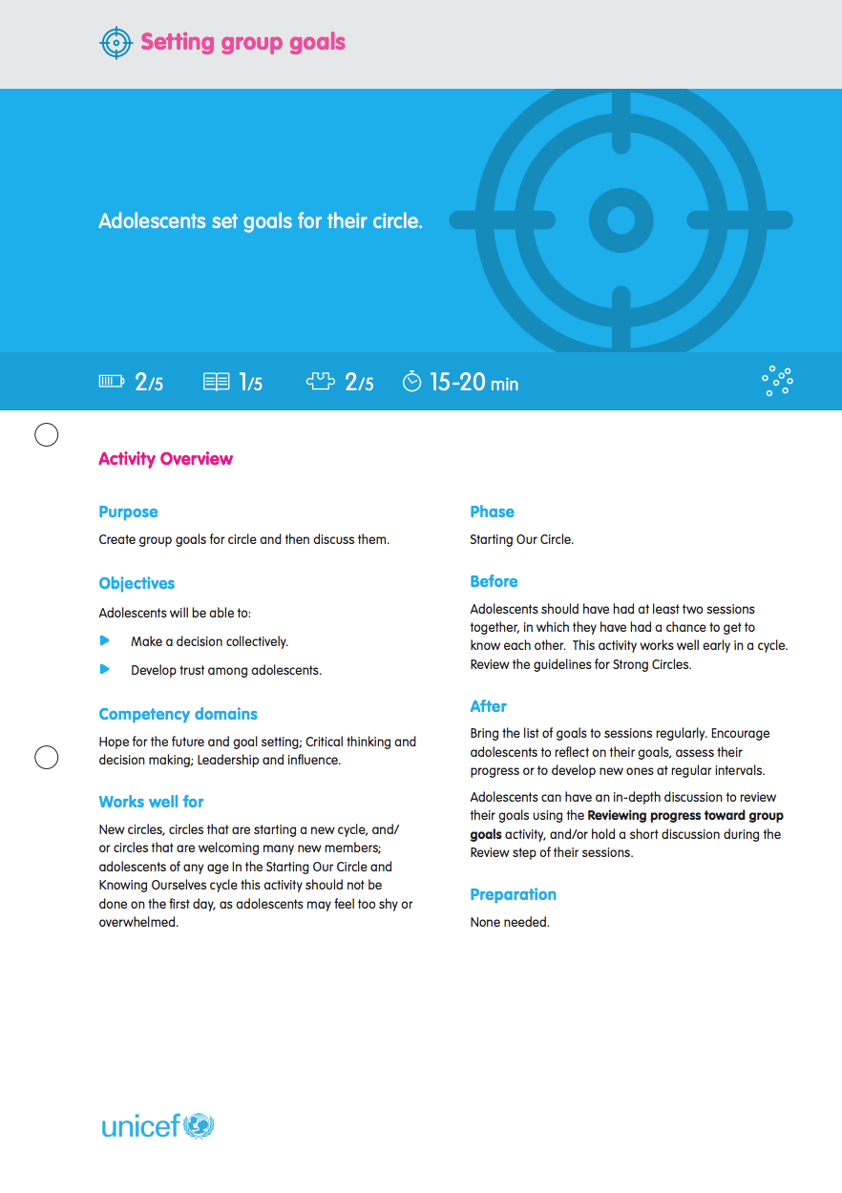
Notes:
Notes for trainer:
Explain: Giving adolescents an opportunity to reflect on and share their own goals for their time together in the Adolescent Circle is a key step for planning. When facilitators (and programme coordinators, and other adults supporting adolescents) know what adolescents want from their activities – including what they enjoy, and what they hope to achieve – they are better able to plan activities that adolescents find relevant and interesting, and that keep them engaged.
Facilitators can use adolescents’ group goals to determine which activities to choose. If adolescents are interested in developing a certain set of competencies, or just have a kind of activity they enjoy (such as drawing, dancing, writing, building models, or carrying out interviews) facilitators can choose activities from the Activity Box accordingly. Facilitators can also adapt activities to adolescents’ goals. For example, if adolescents in the Connecting or Take Action phases are especially interested in community service, facilitators can plan a sequence of activities that guides adolescents through the process of planning and carrying out a project with a focus on community service.
Adolescents starting a new phase should have a chance to discuss and agree to their goals during one of the earliest sessions in that phase. The Setting group goals activity can be a helpful tool to do this.
Ref: Activity Guide: Setting group goals

Slide 29
Prepare a draft Activity Phase plan using the Phase planning tool.
Prepare to support facilitators in using and adapting this plan based on what they learn from adolescents when they carry out the ‘Setting group goals activity.’
Facilitators and adolescents can also ‘start over’ by developing a new, original activity phase plan if they think that would be more appropriate or relevant.
Notes:
Notes for trainer:
Read this slide aloud, or ask one of the workshop participants to do so.

Slide 30
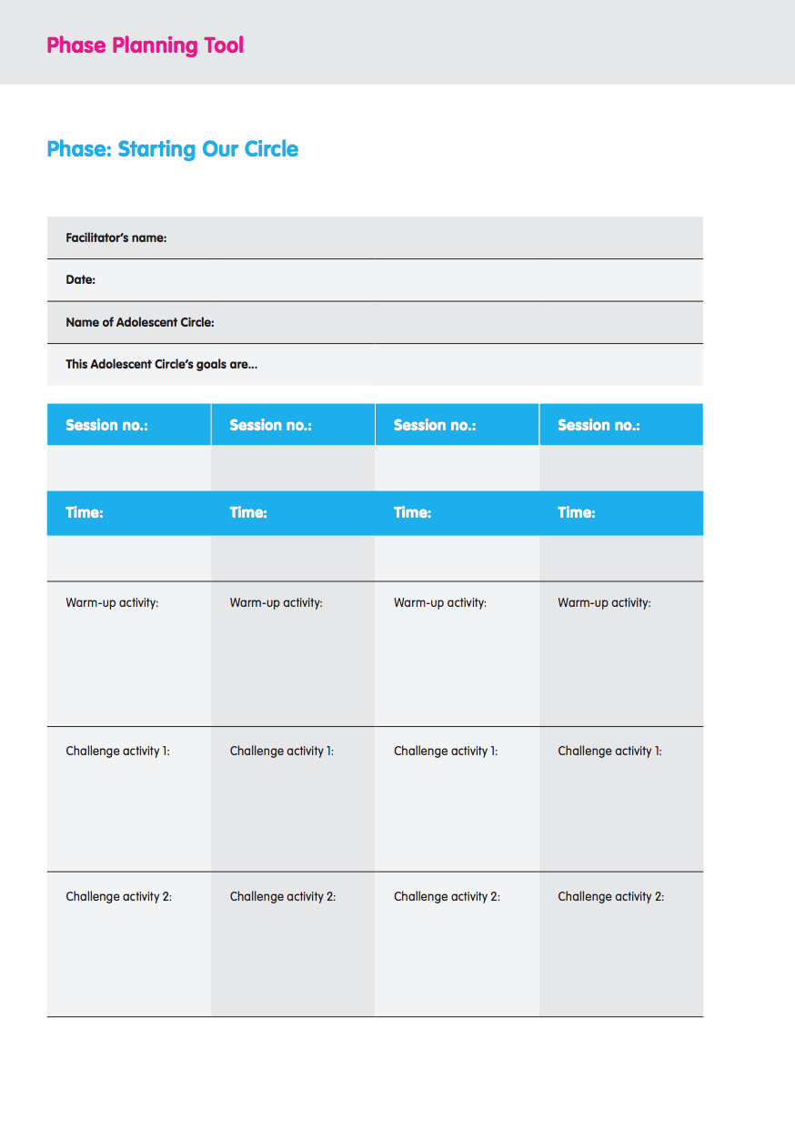
Plan an Activity Cycle for an Adolescent Circle
Notes:
Notes for trainer:
Divide participants into small groups.
This slide and the three that follow present the templates from the Phase planning tool in the Activity Box. Workshop participants should have (or make a copy of) the templates to fill out together as they participate in this activity, using whichever template corresponds with the phase they have identified for the adolescents with whom they work, and use it to develop an activity phase. Project whichever slide is appropriate to the phase participants have selected.
Workshop participants should have and use the resources in the Activity Box as they carry out this planning exercise.
Workshop participants should also refer to the planning guidance for each phase in the Facilitators Guide: Choosing and planning an activity phase.
If necessary or helpful, clarify that…
Activity phases should include at least ten sessions, but can include as many sessions as facilitators think appropriate for the adolescents with whom they are working.
The Starting Our Circle phase planning template includes space for two ‘challenge activities’ because short, easy activities work best in this phase, and facilitators may find that at least three such activities are required to fill a 45 minute session.
The other three phase planning templates have the same format.
Ref: The Activity Box (entire)
Ref: Phase planning tool

Slide 31
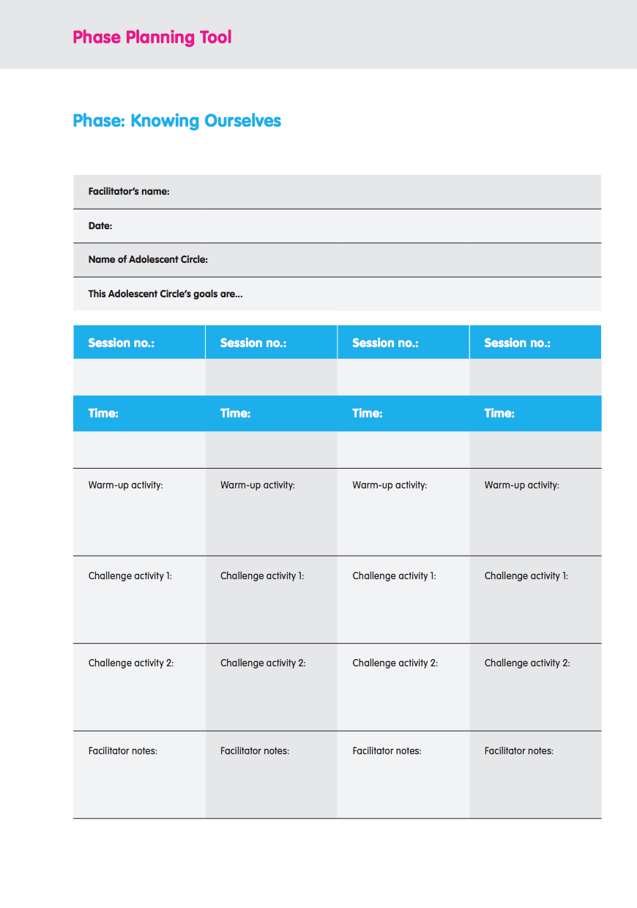
Notes:
Notes for trainer:
Divide participants into small groups.
This slide and the three that follow present the templates from the Phase planning tool in the Activity Box. Workshop participants should have (or make a copy of) the templates to fill out together as they participate in this activity, using whichever template corresponds with the phase they have identified for the adolescents with whom they work, and use it to develop an activity phase. Project whichever slide is appropriate to the phase participants have selected.
Workshop participants should have and use the resources in the Activity Box as they carry out this planning exercise.
Workshop participants should also refer to the planning guidance for each phase in the Facilitators Guide: Choosing and planning an activity phase.
If necessary or helpful, clarify that…
Activity phases should include at least ten sessions, but can include as many sessions as facilitators think appropriate for the adolescents with whom they are working.
The Starting Our Circle phase planning template includes space for two ‘challenge activities’ because short, easy activities work best in this phase, and facilitators may find that at least three such activities are required to fill a 45 minute session.
The other three phase planning templates have the same format.
Ref: The Activity Box (entire)
Ref: Phase planning tool

Slide 32
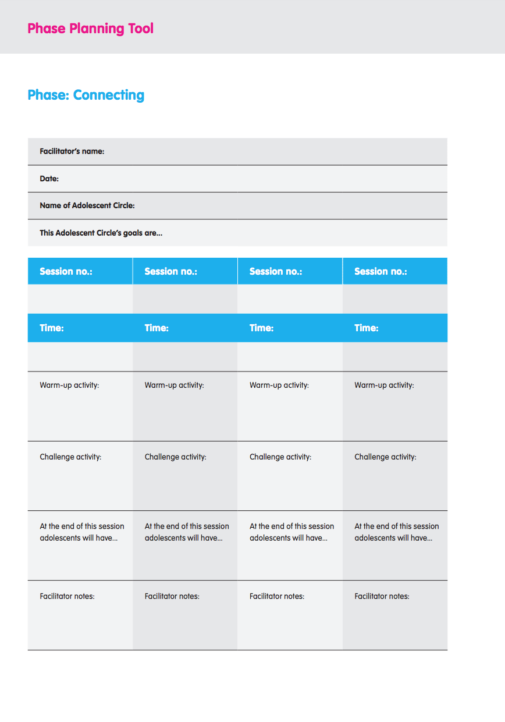
Notes:
Notes for trainer:
Divide participants into small groups.
This slide and the three that follow present the templates from the Phase planning tool in the Activity Box. Workshop participants should have (or make a copy of) the templates to fill out together as they participate in this activity, using whichever template corresponds with the phase they have identified for the adolescents with whom they work, and use it to develop an activity phase. Project whichever slide is appropriate to the phase participants have selected.
Workshop participants should have and use the resources in the Activity Box as they carry out this planning exercise.
Workshop participants should also refer to the planning guidance for each phase in the Facilitators Guide: Choosing and planning an activity phase.
If necessary or helpful, clarify that…
Activity phases should include at least ten sessions, but can include as many sessions as facilitators think appropriate for the adolescents with whom they are working.
The Starting Our Circle phase planning template includes space for two ‘challenge activities’ because short, easy activities work best in this phase, and facilitators may find that at least three such activities are required to fill a 45 minute session.
The other three phase planning templates have the same format.
Ref: The Activity Box (entire)
Ref: Phase planning tool

Slide 33
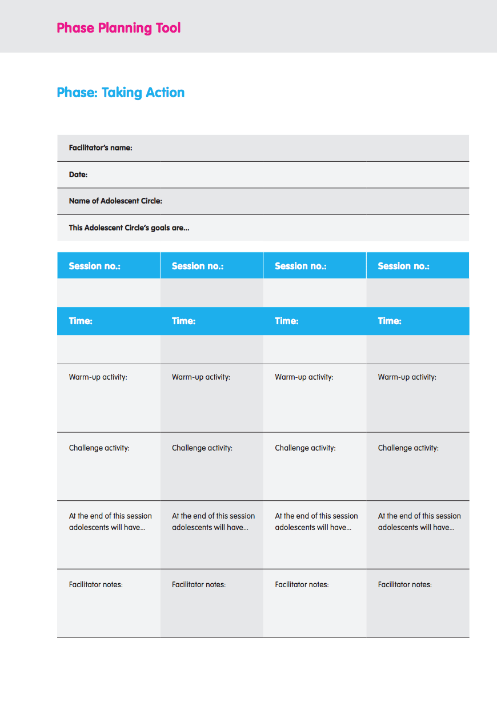
Notes:
Notes for trainer:
Divide participants into small groups.
This slide and the three that follow present the templates from the Phase planning tool in the Activity Box. Workshop participants should have (or make a copy of) the templates to fill out together as they participate in this activity, using whichever template corresponds with the phase they have identified for the adolescents with whom they work, and use it to develop an activity phase. Project whichever slide is appropriate to the phase participants have selected.
Workshop participants should have and use the resources in the Activity Box as they carry out this planning exercise.
Workshop participants should also refer to the planning guidance for each phase in the Facilitators Guide: Choosing and planning an activity phase.
If necessary or helpful, clarify that…
Activity phases should include at least ten sessions, but can include as many sessions as facilitators think appropriate for the adolescents with whom they are working.
The Starting Our Circle phase planning template includes space for two ‘challenge activities’ because short, easy activities work best in this phase, and facilitators may find that at least three such activities are required to fill a 45 minute session.
The other three phase planning templates have the same format.
Ref: The Activity Box (entire)
Ref: Phase planning tool

Slide 34
Debrief: Share your Activity Phase
Notes:
Notes for trainer:
Ask each group to present their draft activity phase plans.
Workshop participants should share constructive feedback in response to each of the draft plans shared.
Discuss and develop plans for how workshop participants will use the draft activity phase plans to support facilitators in preparing to use the resources in the Adolescent Kit for Expression and Innovation. This can include opportunities for facilitators to adapt plans based on what they learn from adolescents about their own goals, as well as their own understanding of adolescents’ needs, interests and capacities.

Slide 35
Thank you!

